Slide 1
Validation and Uncertainty

Slide 2
Validation and Uncertainty
Outline
Sources of error
Accuracy and precision
Error and uncertainty
Validation methods

Slide 3
Error
Difference between reality and our representation of reality

Slide 4
Common Sources of Error
Measurement errors
Field
Laboratory
Digitization errors
Aggregation and Extrapolation errors
Classification errors
Generalization errors
Interpolation errors
Interpretation errors
Heuvelink (2012)
Notes:
The KSSL participates in the International Soil Exchange, and receives 4 samples quarterly from Wageningen University (Wageningen, 2010), There are about 20 or so laboratories around the world that participate. These error are important (especially for research), but are usually less than field based errors.
Field measurements of remotes sensing can have errors in location or value.
The other source of uncertainty of the use of what we call pedotransfer functions (ptf) to predict (model) a measured soil property from another measured soil property.

Slide 5
Error
Example
Map says soil organic C = 30 g/kg at some location
True value = 45 g/kg
Error = 45 – 30 = 15 g/kg

Slide 6
Error
Problem
We usually do not know the error (because if we did, we would eliminate it)
But in many cases we do know something
We may know that the error has equal chance of being positive or negative
We may know that it is unlikely that the absolute value of the error is greater than a given threshold
In other words, we are uncertain about the true value but not completely ignorant
Heuvelink (2012)

Slide 7
Accuracy and Precision
Accuracy
Degree to which a representation of reality is close to reality (∼ inverse of error)
Precision
Degree to which repeated measurements under unchanged conditions show the same results

Slide 8
Accuracy
Accurate
Inaccurate
(systematic error)
Precise
Precision
Imprecise
(reproducibility error)

Slide 9
Error and Uncertainty
Uncertainty arises when we are not sure about the ‘true’ state of the environment; it is an expression of confidence based on limited knowledge
Uncertainty is an acknowledgement of error: we are aware that our representation of reality may differ from reality and express this by being uncertain
Uncertainty is subjective; one person can be more uncertain than another
In the presence of uncertainty, we cannot identify a true ‘reality’. But perhaps we can identify all possible realities and a probability for each one.
Heuvelink (2012)
Notes:
Example: temperature Lincoln, Monday next week
Usually, when referring to measurements directly or indirectly “precision” and “accuracy” are the preferred terms.
When dealing with predictions or modeling, then the “uncertainty” term would be preferred.
However, others can argue that errors and uncertainty are not very different. At one level both can describe the deviation of a true (measured) value from predicted (either via analytical method or modeling). Analytical methods are also modeling in some sense as we use chemicals or sensors to measure a certain quantity and generate a number (prediction), but we know with certainty that the number varies slightly each time we perform the same analysis. The true value in a sense is like a moving target.

Slide 10
Exercise
At the end
Got through the .rmd examples.
Think about
how can you describe you certainty about population features?
how can you asses the relationships between variables?
how can you assess the uncertainty of your models and predictions?

Slide 11
Validation: Assess Uncertainty
Three types of validation
Apparent
Performance on sample used to develop model
Internal
Performance on population underlying the sample
External
Performance on related but slightly different population
Notes:
The previous graph showed the apparent validity of a regression model. It is of more interest to study the internal validity, that is the performance on an underlying population (also labelled ‘reproducibility’), or external validity, that is the performance on a different population (also labelled ‘generalizability’ or ‘transportability’).

Slide 12
Apparent Validation
Goodness of fit
Correlation (r², R², adjusted R²)
P-values (model, individual variables)
ANOVA
Residuals
Heteroscedasticity (plot residuals vs. predicted)
Non-normality (histogram, QQ plot)
Spatial autocorrelation (Moran’s I)

Slide 13
Heteroscedasticity
Standardized Residuals
Standardized Residuals
Predicted y
Predicted y
Standardized Residuals
Standardized Residuals
Predicted y
Predicted y
Notes:
heteroscedasticity (also spelled heteroskedasticity) refers to the circumstance in which the variability of a variable is unequal across the range of values of a second variable that predicts it.
In statistics, a collection of random variables is heteroscedastic (or heteroskedastic;^{[notes 1]} from Ancient Greek hetero “different” and skedasis “dispersion”) if there are sub-populations that have different variabilities from others. Here "variability" could be quantified by the variance or any other measure of statistical dispersion. Thus heteroscedasticity is the absence of homoscedasticity.
The existence of heteroscedasticity is a major concern in the application of regression analysis, including the analysis of variance, as it can invalidate statistical tests of significance that assume that the modelling errors are uncorrelated and uniform—hence that their variances do not vary with the effects being modeled. For instance, while the ordinary least squares estimator is still unbiased in the presence of heteroscedasticity, it is inefficient because the true variance and covariance are underestimated.^{[1][2]} Similarly, in testing for differences between sub-populations using a location test, some standard tests assume that variances within groups are equal.

Slide 14
Apparent Validation
Analysis of residuals
Heteroscedasticity, non-normality, or spatial autocorrelation indicates
One or more important variables were omitted from the model
subpopulations
Incorrect functional form used for the model (e.g., linear when the function is actually nonlinear)

Slide 15
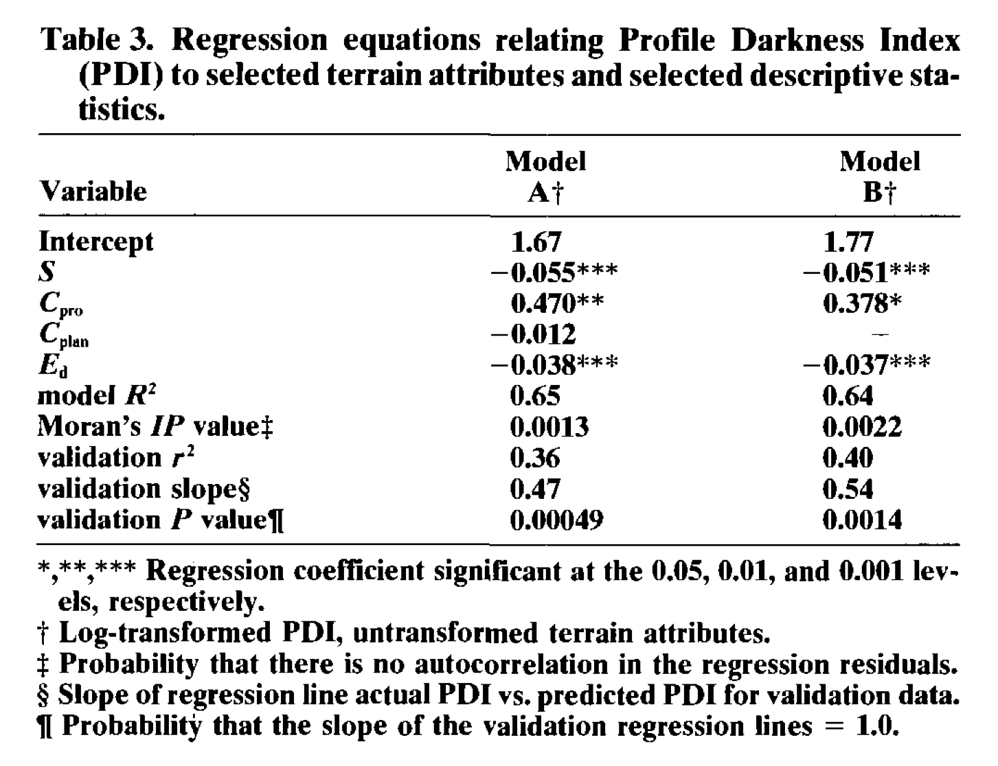
Apparent Validation
Thompson et al. (1997)
Notes:
Thompson, James A., James C. Bell, and Charles A. Butler. "Quantitative soil-landscape modeling for estimating the areal extent of hydromorphic soils." Soil Science Society of America Journal 61.3 (1997): 971-980.

Slide 16
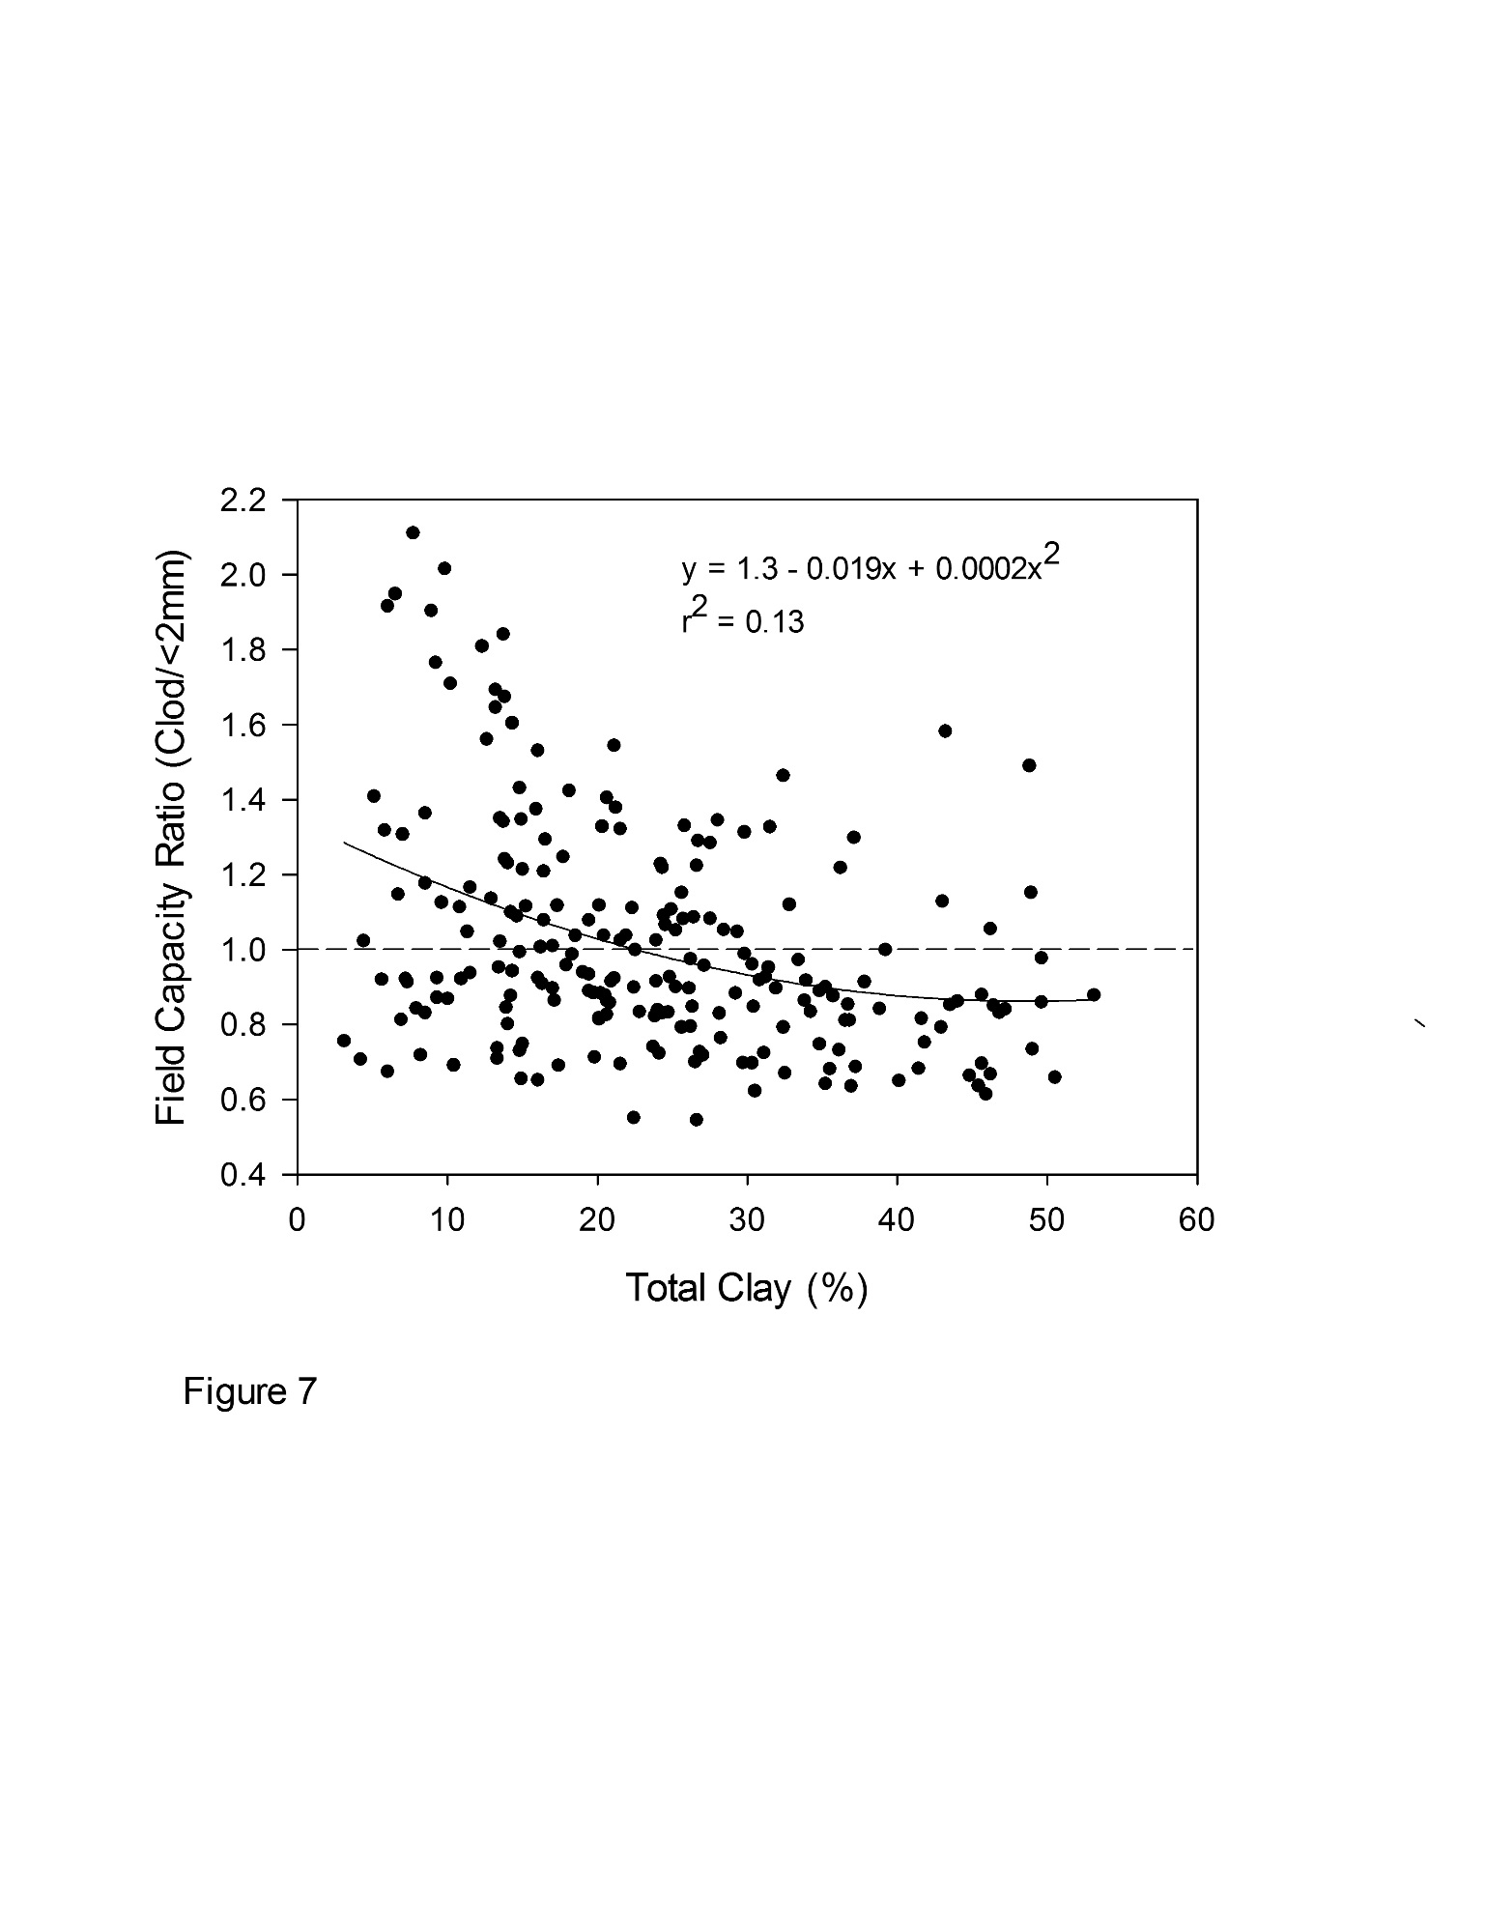
Libohova et al., 2017
Notes:
From work being done by staff a the soil survey center to relate SOC to water holding capacity.

Slide 17
Internal Validation
Split-sample
Training data
Validation data
Cross-validation
Alternating development and validation
Jack-knife
n-1 for training, 1 validate
Bootstrap
Random subsample
Notes:
Three internal validation techniques are shown. Split-sample means that a random split is made, resulting in e.g. a 50% development and a 50% validation sample. Cross-validation uses the same principle, but alternates the development and validation samples (e.g. 50:50 split means 2 development and test rounds; a 90:10 split 10 rounds). The most extreme variant of cross-validation is the ‘jack-knife’, where n-1 patients are used for model development, with validation on the patient who was left out. The bootstrap is however the preferred technique (see next slide).

Slide 18
Internal Validation
Methods to assess error
Numerical data
Correlation (r²)
Scatter plots
Mean error (ME)
Root mean square error (RMSE)
Categorical data
Confusion matrix (error matrix)

Slide 19
Internal Validation
Split-sample
Training
Test (validation)
Cross-validation
Leave-one-out
K-fold
Jack-knife
n-1 for training, 1 validate
Bootstrap
Random subsample
Test
Train
Total number of samples
Notes:
A key characteristic is that data for model development and evaluation are both random samples from the same underlying population.
Three internal validation techniques are shown. Split-sample means that a random split is made, resulting in e.g. a 50% development and a 50% validation sample.
Cross-validation uses the same principle, but alternates the development and validation samples (e.g. 50:50 split means 2 development and test rounds; a 90:10 split 10 rounds). The most extreme variant of cross-validation is the ‘jack-knife’, where n-1 samples are used for model development, with validation on the sample that was left out.
The bootstrap is however the preferred technique.

Slide 20
Internal Validation
Split-sample
Training
Test (validation)
Cross-validation
Leave-one-out
K-fold
Jack-knife
Bootstrap
Random subsample
Test
Train
Train
Total number of samples
Train
Notes:
Leave-one-out
There is often not enough data to allow some of it to be kept back for testing. In that case, a leave-one-out approach may be a more efficient use of the available data, as you only omit one observation for each iteration for n observations.
-all the samples in the dataset are eventually used for both training and testing
-average of errors are used to report the overall cross-validation
-LOOCV is a special case of Kfolds CV, where K=N

Slide 21
Internal Validation
Split-sample
Training
Test (validation)
Cross-validation
Leave-one-out
K-fold
Jack-knife
Bootstrap
Random subsample
K=3
Test
Train
Total number of samples
Test Test
Train
Test
Train
Train
Notes:
K-fold
–a variation of leave-one-out where K does not equal N; instead K is user specified
-all the samples in the dataset are eventually used for both training and testing
-averages error across all folds to determine x-validation error
-The choice of K, is a classic problem of bias-variance trade-off

Slide 22
Internal Validation
Split-sample
Training
Test (validation)
Cross-validation
K-fold
Leave-one-out
Jack-knife
Bootstrap
Random subsample
Test
Total number of samples
Train
Train
Train
Similar to leave-one-out method, but computes bias rather than an average of model error; more than one sample can be left out.
Notes:
Jack-knife
In the previous cross-validation examples, we’ve computed a statistic on the left-out sample(s) (ie trained the model and tested it on the left out samples—we then averaged all errors together to reach an overall MSE). In jackknifing, you compute a statistic from the left-out samples and compare it to the corresponding statistic computed from the entire sample….estimating the bias of a statistic.

Slide 23
Internal Validation
Split-sample
Training
Test (validation)
Cross-validation
K-fold
Leave-one-out
Jack-knife
Bootstrap
Random subsample
Test
Train
Total number of samples
A random variation of jack-knife
Random sampling with replacement
Notes:
Both jack-knife and bootstrapping estimate the bias and standard error (variance) of a statistic (mean, median, r, etc.) by leaving out one or more observations at a time from the sample set. Bootstrap, however, is a random variation of Jack-knife.
In statistics, bootstrapping can refer to any test or metric that relies on random sampling with replacement. Also called Monte-Carlo sampling.

Slide 24
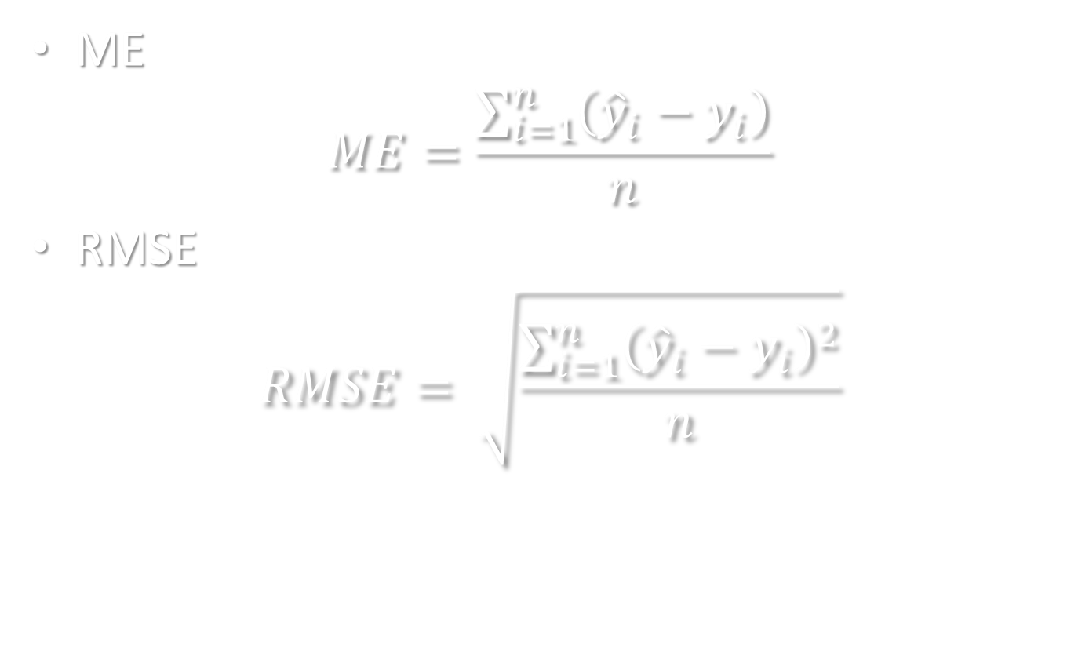
Internal Validation
ME
$$ME=\frac{\sum_{i=1}^{n}{\left({\hat{y}}_{i}−y_{i}\right)}}{n}$$
RMSE
$$RMSE= \sqrt{\frac{\sum_{i=1}^{n}{{\left({\hat{y}}_{i}−y_{i}\right)}^{2}}}{n}}$$

Slide 25
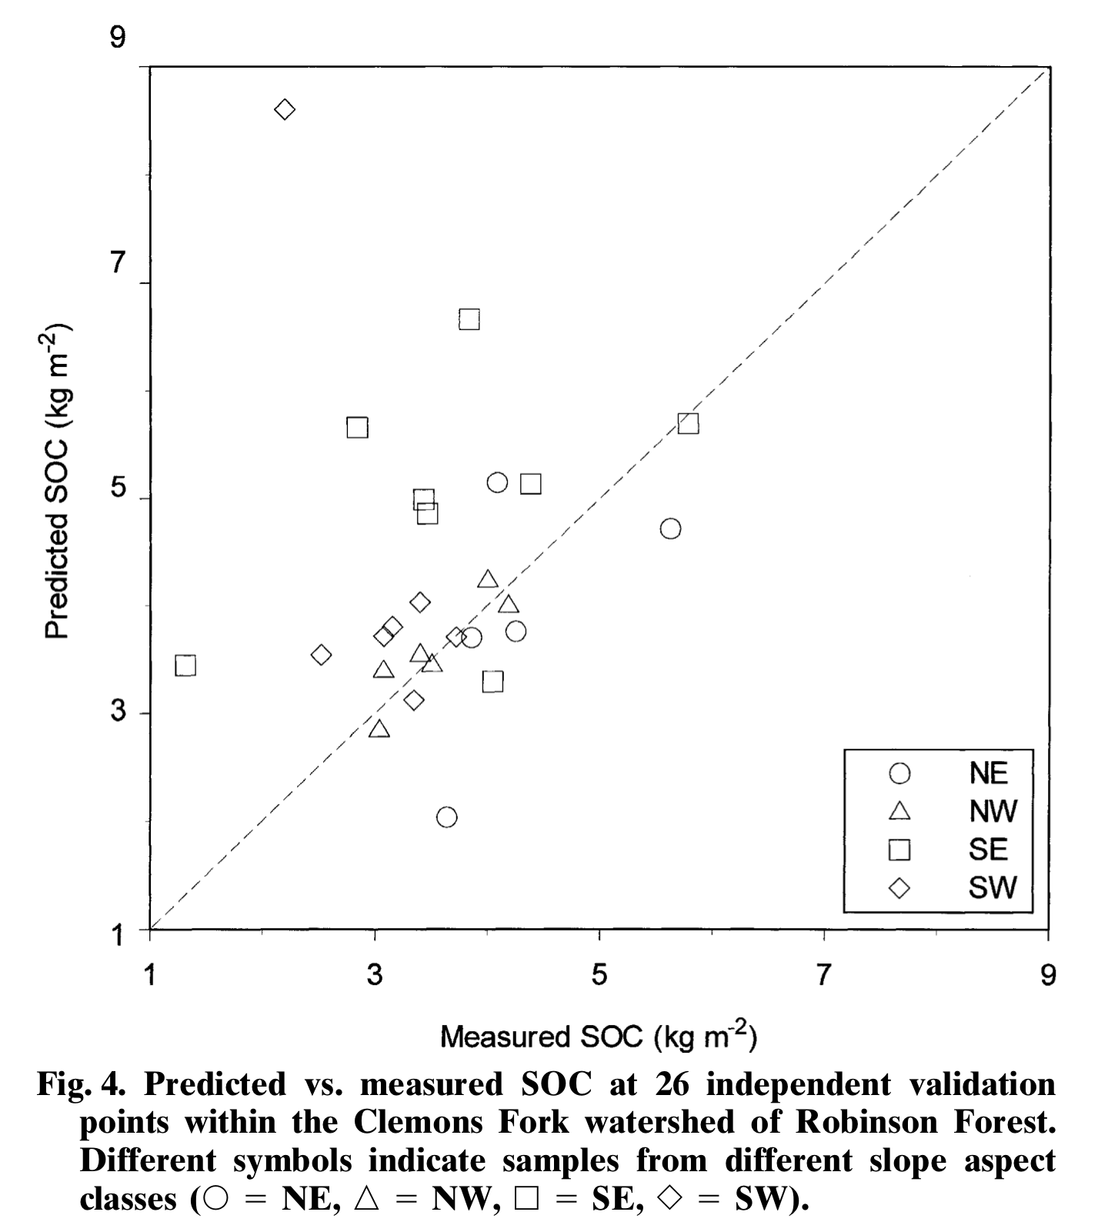
Internal Validation
Thompson and Kolka (2005)

Slide 26
Internal Validation
Thompson et al. (1997)

Slide 27
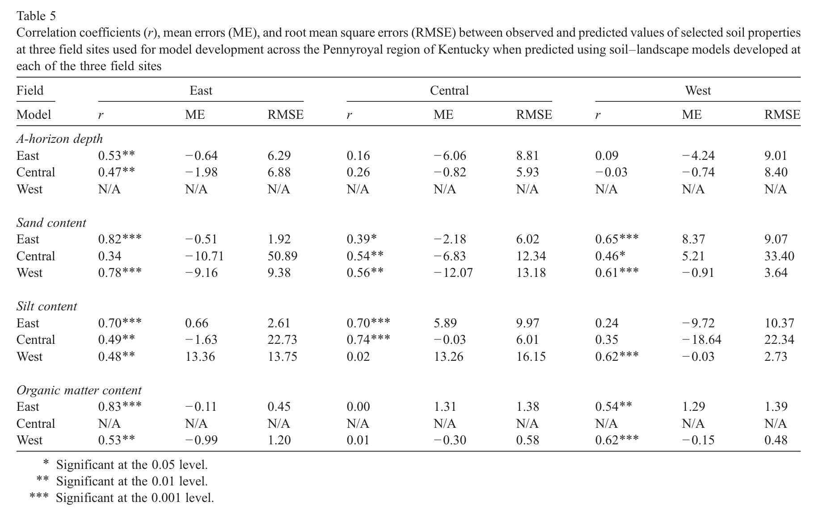
Internal Validation
Thompson et al. (2006)
Notes:
The model is tested against the same data it was developed with.
Thompson, James A., Eugenia M. Pena-Yewtukhiw, and John H. Grove. "Soil–landscape modeling across a physiographic region: Topographic patterns and model transportability." Geoderma 133.1 (2006): 57-70.

Slide 28
Confusion Matrix
Types of Accuracy
Overall Accuracy
Number of correct observations divided by total number of observations
User’s Accuracy
Probability that a class on the map actually represents that category on the ground
Producer’s Accuracy
Probability that a ground reference observation was assigned to the correct class in the map
Notes:
Overview of the kinds of accuracy that will be introduced in the next three slides.

Slide 29
Internal Validation
 |  | Reference Data
 | Class | Gypsic | Natric | Neither | Row Total | User’s Accuracy
Class Data | Gypsic | 21 | 0 | 0 | 21 | 21/21 = 100%
 | Natric | 0 | 14 | 3 | 17 | 14/17 = 82.4%
 | Neither | 3 | 13 | 39 | 55 | 39/55 = 70.9%
 | Column Total | 24 | 27 | 42 | 93
 | Producer’s Accuracy | 21/24 = 87.5% | 14/27 = 51.9% | 39/42 = 92.9% |  | Overall Accuracy 74/93=79.6%
Notes:
Let’s populate an error matrix with the accuracy assessment data from the San Rafael Swell (Nield et al., 2007).
Nield, S. J., J. L. Boettinger, and R. D. Ramsey. "Digitally mapping gypsic and natric soil areas using Landsat ETM data." Soil Science Society of America Journal 71.1 (2007): 245-252.

Slide 30
Internal Validation
 |  | Reference Data
 | Class | Gypsic | Natric | Neither | Row Total | User’s Accuracy
Class Data | Gypsic | 21 | 0 | 0 | 21 | 21/21 = 100%
 | Natric | 0 | 14 | 3 | 17 | 14/17 = 82.4%
 | Neither | 3 | 13 | 39 | 55 | 39/55 = 70.9%
 | Column Total | 24 | 27 | 42 | 93
 | Producer’s Accuracy | 21/24 = 87.5% | 14/27 = 51.9% | 39/42 = 92.9% |  | Overall Accuracy 74/93=79.6%
Notes:
Let’s populate an error matrix with the accuracy assessment data from the San Rafael Swell (Nield et al., 2007).

Slide 31
External Validation
Take a previously developed model and apply it to novel (new) data

Slide 32
External Validation
Thompson et al. (2006)
Notes:
External validation – the model from one region is being applied to another
Thompson, James A., Eugenia M. Pena-Yewtukhiw, and John H. Grove. "Soil–landscape modeling across a physiographic region: Topographic patterns and model transportability." Geoderma 133.1 (2006): 57-70.

Slide 33
Example of Soil Taxa Mapping

Slide 34
Regression Tree Model
Random Forest probability model of spodic expression (i.e., SI = 0 vs. SI > 0)
Topographic spatial layers from 30-m National Elevation Dataset digital elevation model
Remote sensing layers from Landsat Geocover 2000
Nauman et al. (2015)
Notes:
Developed a GIS database of raster layers to try and model where spodic morphology is found.
http://www.sciencedirect.com/science/article/pii/S0016706115000427
Nauman, Travis W., et al. "Ghosts of the forest: Mapping pedomemory to guide forest restoration." Geoderma 247 (2015): 51-64.

Slide 35
Validation
Apparent Validation
Full model (n=322)
Out Of Bag error = 29.5%
Internal Validation
Split-sample
Training set (n=208)
Test set (n=114)
0.57 probability threshold
Error = 30%
External Validation
Independent plot data (n=24)
88.1% accuracy
Nauman et al. (2015)
Notes:
To get a more continuous model, a random forest probability model was produced.
Combines many trees built using random sample subsets and random variable-subset selection to create more robust model.
Determined threshold by holding back 33% of data from a model run and adjusting prob thresh to get best confustion matrix.

Slide 36
Validation
Confusion matrix
User’s
Accuracy
0.57 threshold |  | observed
 |  | no spod | spod
predicted | no spod | 19 | 22 | 46.3%
 | spod | 12 | 61 | 83.6%
 |  | 61.3% | 73.5% | 70.2%
Producer’s
Accuracy
Overall
Accuracy
Nauman et al. (2014)
Notes:
“The validation results using withheld data indicated a maximum classification agreement at a 0.57 probability threshold to separate spodic from non-spodic predictions and indicated that predictions of spodic sites were more reliable than those of non-spodic sites (Table 3). “

Slide 37
From Nauman et al., 2015
“The validation results using withheld data indicated a maximum classification agreement at a 0.57 probability threshold to separate spodic from non-spodic predictions and indicated that predictions of spodic sites were more reliable than those of non-spodic sites (Table 3). “
What kind of validation is this?
Discuss the appropriateness of the metric described.

Slide 38
Compare Models
Model comparison can be based on apparent, internal or external validation
Depends on the use of the model
Error Rates and ANOVA (p tests between models) are two possible ways to compare models

Slide 39
Questions?

Slide 40
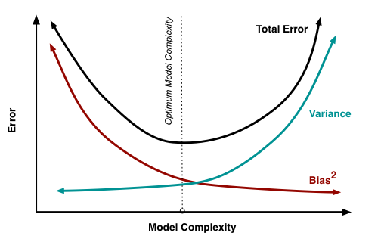
Classic Trade-off
Fortmann-Roe, 2012

Slide 41
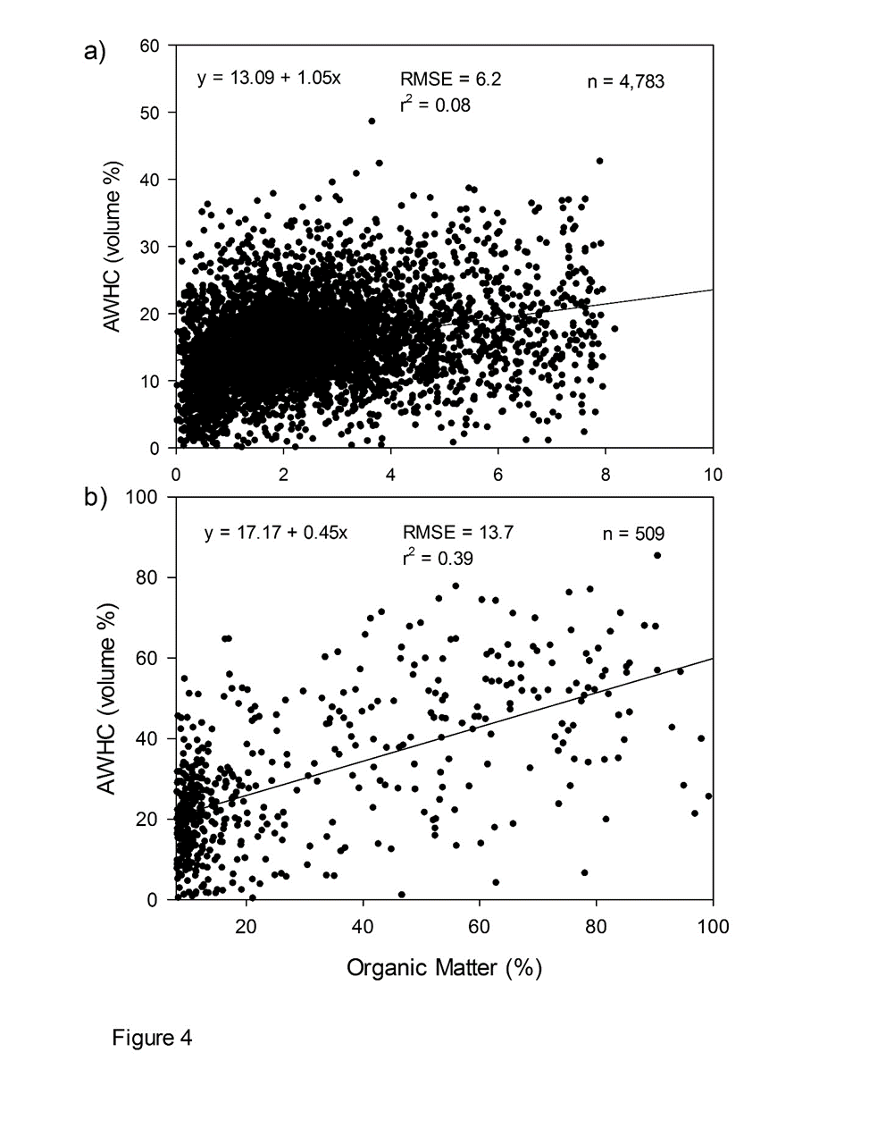
Libohova et al., 2017
Notes:
From work being done by staff a the soil survey center to relate SOC to water holding capacity.

Slide 42
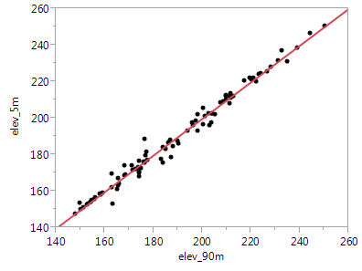
Let’s assume that the elevation is accurate and that we only have ONE data source (2005 High resolution aerial Image – Indiana example)
Dillon_Cr_WSH_ SD_TA.xlsx
Dillon_Cr_WSH_ SD_TA.txt
Dillon_Cr_WSH_ SD_TA.csv
R2 = 0.98
RMSE = 3.30
R2 = 0.98
RMSE = 3.30
Notes:
We start first with spatial data or data sources.
This is Dillon Creek HUC 12 watershed in MLRA 127 in southern Indiana.
We extracted elevation data to 95 georeferenced points with measured soil depth to paralithic.
The RMSE between 5 and 90 m grid resolution is about 3.3 m.
That may not seem too bad, well until we start thinking about deriving some derivatives from the elevation.
Data Files in different formats:
Dillon_Cr_WSH_ SD_TA.xlsx
Dillon_Cr_WSH_ SD_TA.txt
Dillon_Cr_WSH_ SD_TA.csv
Projection: NAD83 UTM 16N
Exercise: A simple R code to explore data (co-linearity etc.), multiple regressions and some residuals and plot them graphically. Print the info to see the model performance.

Slide 43
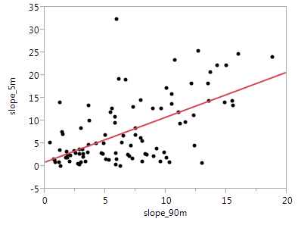
Slope is the first derivative of elevation.
Rise
(change in elevation)
Slope (%) =
Run (distance)
What happened?
R2 = 0.38
RMSE = 6.0
R2 = 0.98
RMSE = 3.30
Notes:
So, we use slope as an example. Notice now the RMSE that is 6.0%.
Again, the influence of this difference it depends on the use purpose.
When predicting the spatial occurrence of a class (smu) or property the quality/accuracy of the input to make spatial predictions plays a major role.

